Slide 1
Comparing Fractions and Percentages of Quantities
Miss L
Year 11 Essentials

Slide 2
Learning Intentions
Students will be able to
Find the percentage of a quantity
Express one quantity as a percentage of another
Solve problems relating to percentage increase/decrease and profit/loss
Apply this knowledge to real-life scenarios

Slide 3
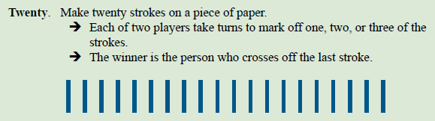
But first,
Notice any patterns?

Slide 4

Think-Pair-Share
With a partner, come up with:
Ways we use percentages in our daily lives
Jobs that regularly deal with percentages
Way they make our lives easier
Share with the class

Slide 5

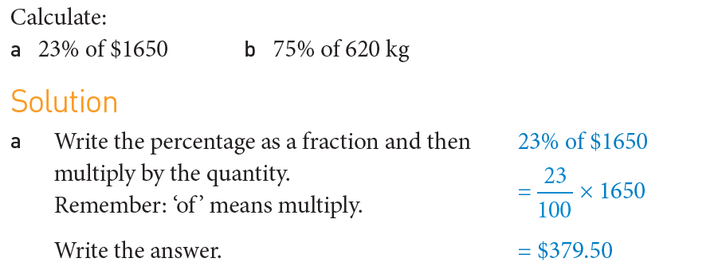
24
7
30
Understanding Percentages Further
Date
EQ – How can we apply our knowledge of percentages to different contexts?
How do we find a % of a quantity?

Slide 6
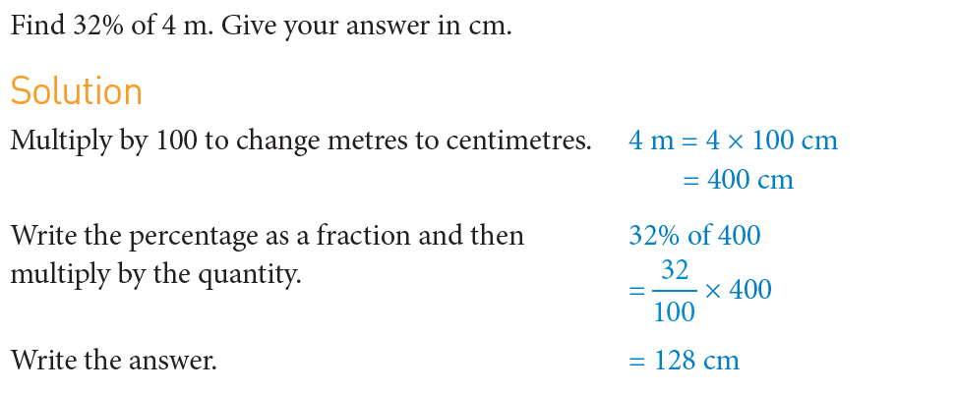
24
7
30
Understanding Percentages Further
Date
EQ – How can we apply our knowledge of percentages to different contexts?
How do we find a % of a quantity?

Slide 7
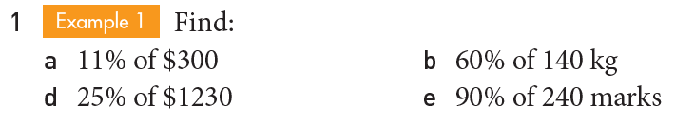
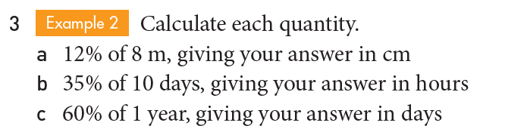
Practice

Slide 8


Slide 9
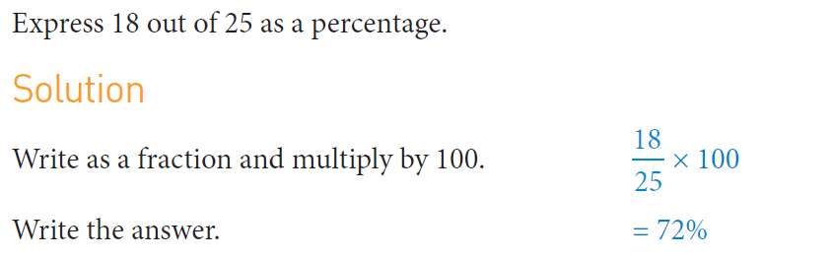
24
7
30
Understanding Percentages Further
Date
EQ – How can we apply our knowledge of percentages to different contexts?
How can we express one quantity as a percentage of another?

Slide 10
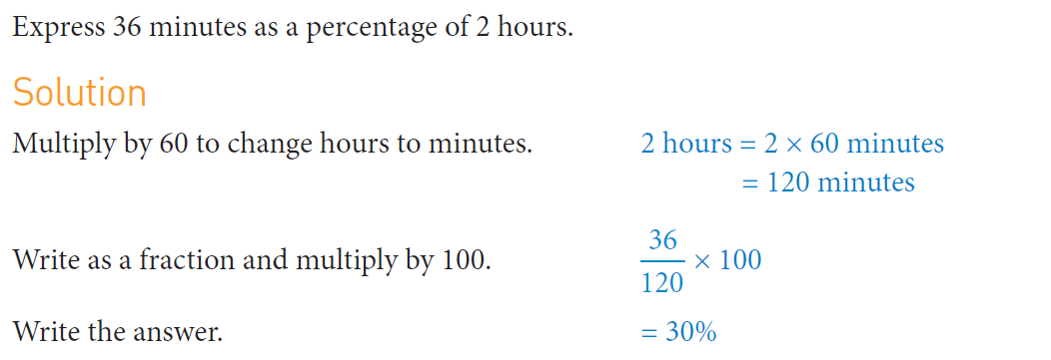
24
7
30
Understanding Percentages Further
Date
EQ – How can we apply our knowledge of percentages to different contexts?
How can we express one quantity as a percentage of another?

Slide 11
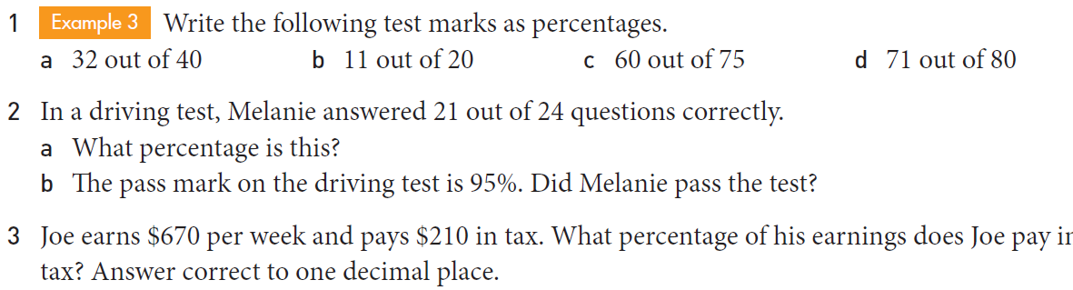
Practice

Slide 13
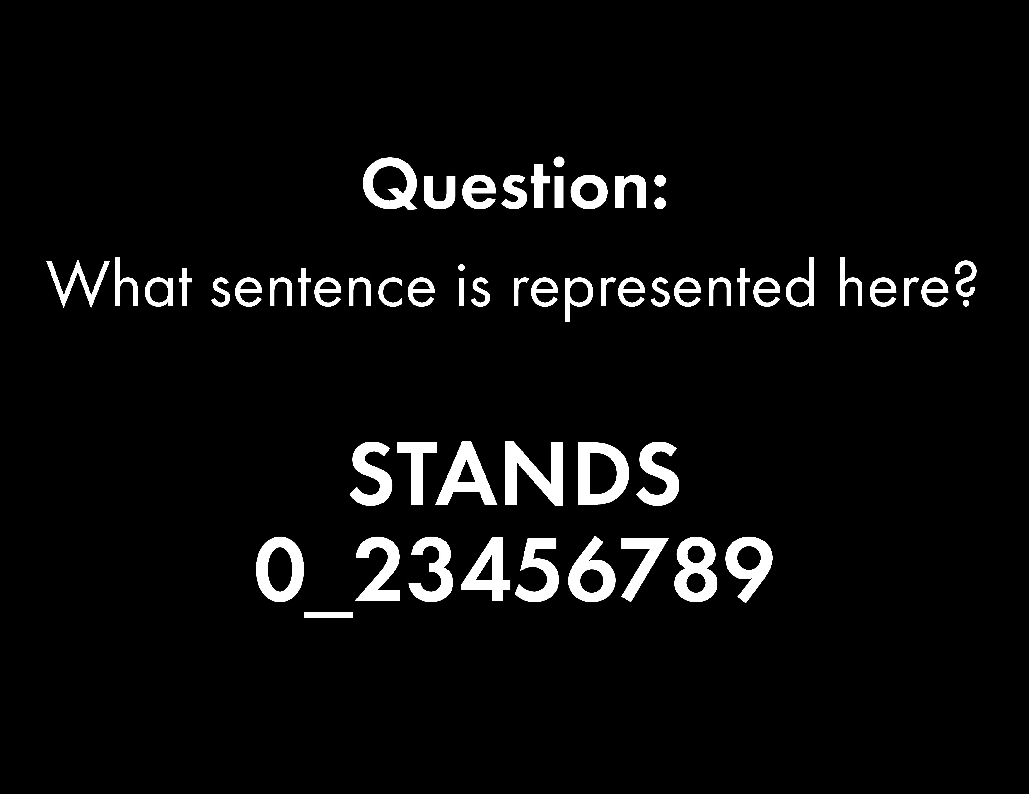

Slide 14
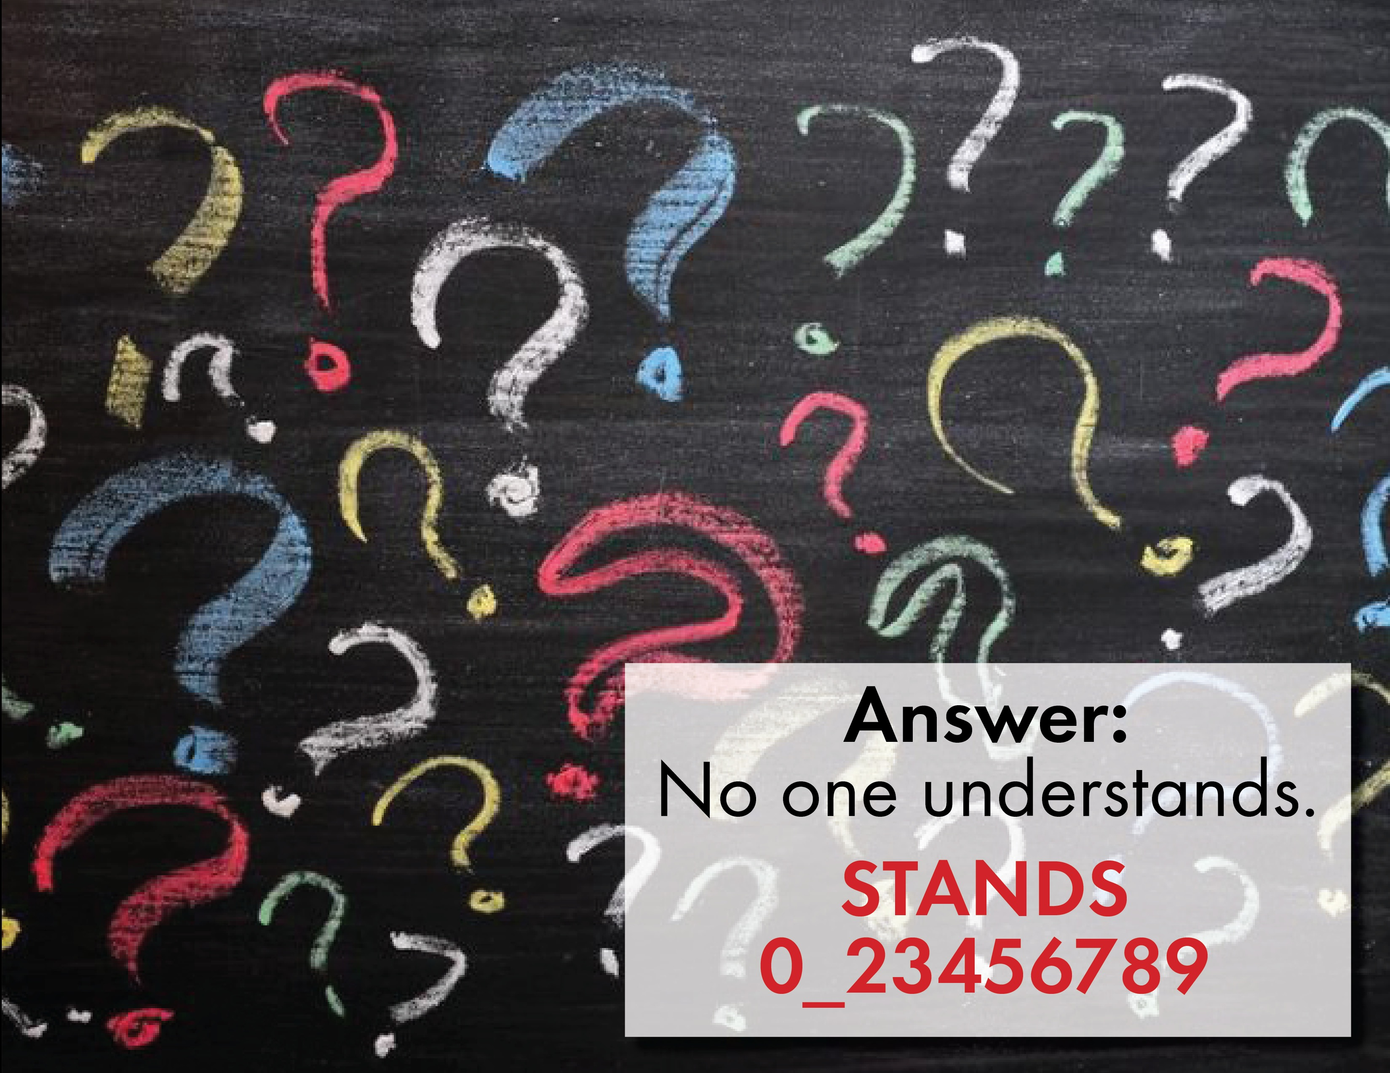

Slide 15
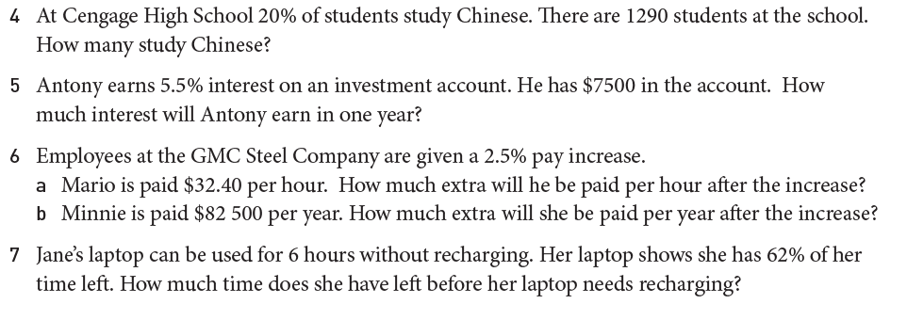
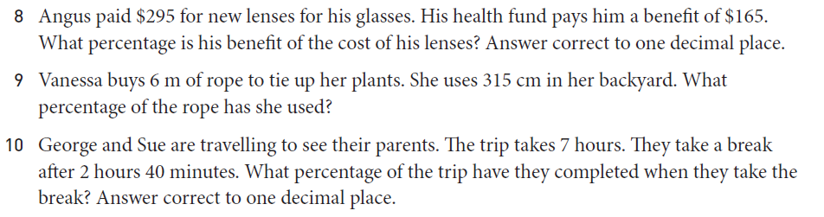

Slide 16
